Slide 1
ACTION
playerCount
check() call() raise() jam() fold() revealYet() reveal()
DECK
cards
shuffle():void deal()
Contains
HAND
getCards():void
CARD--ENUM
number suit
WINNER
noPair onePair twoPairs threeOfAKind straight flush fullHouse fourOfAKind straightFlush royalFlush
hasNoPair() hasOnePair() hasTwoPairs() hasThreeOfAKind() hasStraight() hasFlush() hasFullHouse() hasFourOfAKind() hasStraightFlush() hasRoyalFlush()
Contains
Contains
Contains
Contains
USER
username balance smallBlind bigBlind canPlay
display():void isDealer():bool isBigBlind():bool isSmallBlind():bool balance():int canPlay():bool
Contains
TABLE
stage:enum preflop, flop, turn, river timer pot
display():void isTimeUp():bool

Slide 2
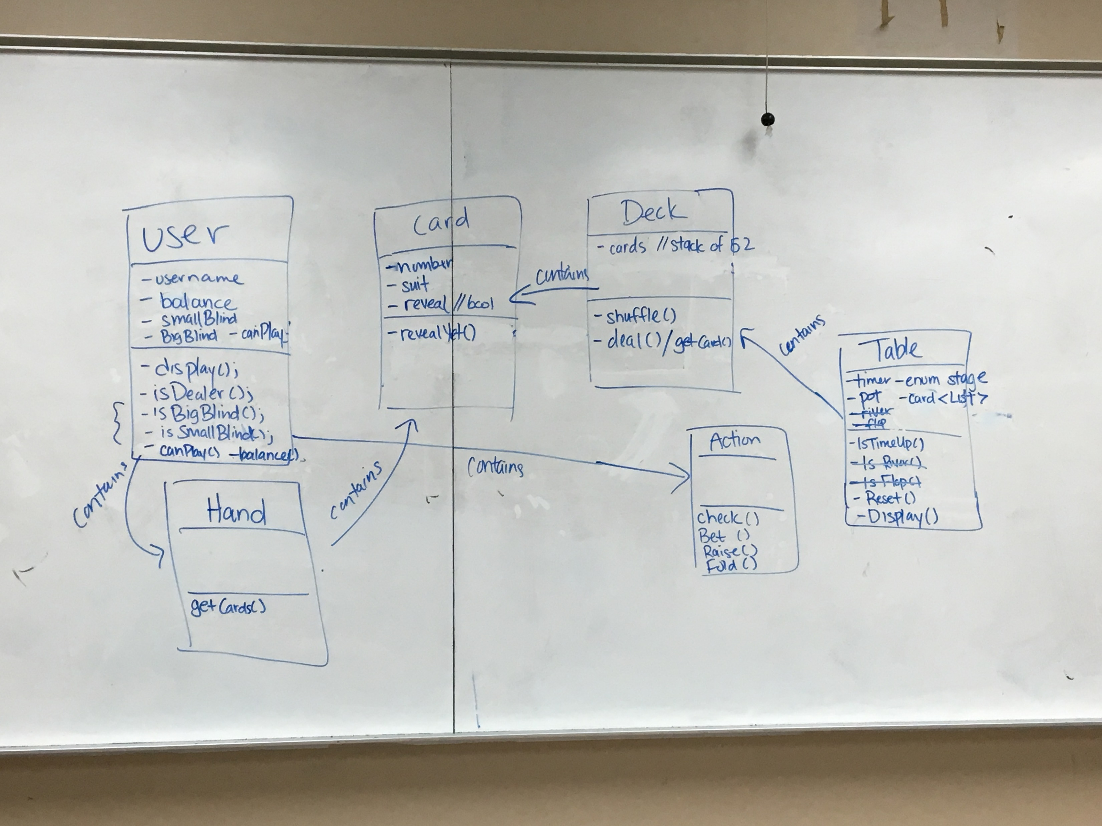

Slide 3
